Slide 1
Python Programming
Unit -4 : Introduction to Numpy and Matplotlib
Topics : Arrays -Creating a NumPy ndarray Object, 1D, 2D and 3D Arrays, Array Indexing, Slicing, Shape, Reshaping, Iteration, Built-in functions -concatenate, array_split, where, sort, Basic Methods -Plot() with different markers, colors, and linestyles, show() Describing the plot -xlabel, ylabel, title with different fonts, colors and positions Grids and subplotsSimple Scatterplots with color, size and alpha, Simple Bar charts bar() and barh(), Simple Histogram with hist(), Simple pie charts with pie along with labelling and coloring.

Slide 2
Numpy Introduction
NumPy stands for numeric python which is a python package for the computation and processing of the multidimensional and single dimensional array elements.
Travis Oliphant created NumPy package in 2005 by injecting the features of the ancestor module Numeric into another module Numarray.
It is an extension module of Python which is mostly written in C. It provides various functions which are capable of performing the numeric computations with a high speed.
NumPy provides various powerful data structures, implementing multi-dimensional arrays and matrices. These data structures are used for the optimal computations regarding arrays and matrices.

Slide 3
Advantages of Numpy
NumPy provides various powerful data structures, implementing multi-dimensional arrays and matrices. These data structures are used for the optimal computations regarding arrays and matrices. Advantages are:
NumPy performs array-oriented computing.
It efficiently implements the multidimensional arrays.
It performs scientific computations.
It is capable of performing Fourier Transform and reshaping the data stored in multidimensional arrays.
NumPy provides the in-built functions for linear algebra and random number generation.

Slide 4
Comparison: NumPy vs Python Lists
Feature | NumPy Array | Python List
Speed | Very fast (uses C internally) | Slower
Data Type | Same data type (homogeneous) | Different data types allowed
Memory Usage | Less memory | More memory
Operations | Supports vectorized operations (no loop needed) | Requires loops
Syntax | Simple for math operations | More code required
Multidimensional Support | Easy (2D, 3D arrays) | Complex to manage
Built-in Functions | Powerful math functions available | Limited
Use Case | Data Science, AI, Scientific computing | General-purpose programming

Slide 5
Numpy
Once NumPy is installed, import it in your applications by adding the import keyword:
Example:
import numpy
NumPy is usually imported under the np alias.
alias: In Python alias are an alternate name for referring to the same thing.

Slide 6
Numpy
Create an alias with the as keyword while importing:
Now the NumPy package can be referred to as np instead of numpy.
Example:
import numpy as np

Slide 7
NumPy ndarray Object
Ndarray is the n-dimensional array object defined in the numpy which stores the collection of the similar type of elements. In other words, we can define a ndarray as the collection of the data type (dtype) objects.
The ndarray object can be accessed by using the 0 based indexing. Each element of the Array object contains the same size in the memory.
The ndarray object can be created by using the array routine of the numpy module.
a = numpy.array

Slide 8
1-D Array
To create an array using the list, use the following syntax.
This is an example of uni-dimensional or 1-D array.
Example:
import numpy as np arr = np.array([1, 2, 3, 4, 5]) print(arr) print(type(arr))
Output: [1 2 3 4 5]
<class ‘numpy.ndarray’>

Slide 9
2-D Array
Array containing two arrays are known as 2-D Array.
Example:
import numpy as np arr = np.array([[1, 2, 3], [4, 5, 6]])
print(arr) print(type(arr))
Output: [[1 2 3]
[4 5 6]]
<class ‘numpy.ndarray’>

Slide 10
3-D Array
An array that has 2-D arrays (matrices) as its elements is called 3-D array.
These are often used to represent a 3rd order tensor.
Example:
import numpy as np arr = np.array([[[1, 2, 3], [4, 5, 6]], [[1, 2, 3], [4, 5, 6]]])
print(arr) print(type(arr))
Output: [[1 2 3]
[4 5 6]]
[[1 2 3]
[4 5 6]]
<class ‘numpy.ndarray’>

Slide 11
Array Indexing
Array indexing is the same as accessing an array element.
You can access an array element by referring to its index number.
The indexes in NumPy arrays start with 0, meaning that the first element has index 0, and the second has index 1 etc.
Example:
import numpy as np arr = np.array([1, 2, 3, 4]) print(arr[0])
Output: 1

Slide 12
Array Indexing
Example -1:
import numpy as np arr = np.array([1, 2, 3, 4]) print(arr[2] + arr[3])
Output: 7
Example - 2:
import numpy as np arr = np.array([[1,2,3,4,5], [6,7,8,9,10]]) print('5th element on 2nd row: ', arr[1, 4])
Output: 10

Slide 13
Array Slicing
Slicing in python means taking elements from one given index to another given index.
We pass slice instead of index like this: [start:end].
We can also define the step, like this: [start:end:step].
If we don't pass start its considered 0.
If we don't pass end its considered length of array in that dimension.
If we don't pass step its considered 1.

Slide 14
Array Slicing
Example - 1:
import numpy as np arr = np.array([1, 2, 3, 4, 5, 6, 7]) print(arr[1:5])
Ouput: [2 3 4 5]
Note: The result includes the start index, but excludes the end index.
Example - 2:
import numpy as np arr = np.array([1, 2, 3, 4, 5, 6, 7]) print(arr[4:])
Ouput: [5 6 7]

Slide 15
Array Slicing
Example - 3:
import numpy as np arr = np.array([1, 2, 3, 4, 5, 6, 7]) print(arr[:4])
Ouput: [1 2 3 4]
Example - 4:
import numpy as np arr = np.array([1, 2, 3, 4, 5, 6, 7]) print(arr[-3:-1])
Ouput: [5 6]

Slide 16
Array Slicing
Use the step value to determine the step of the slicing:
Example - 3:
import numpy as np arr = np.array([1, 2, 3, 4, 5, 6, 7]) print(arr[1:5:2])
Ouput: [2 4]
Example - 4:
import numpy as np arr = np.array([1, 2, 3, 4, 5, 6, 7]) print(arr[ : :2])
Ouput: [1 3 5 7]

Slide 17
Shape and Size of Array
To get the shape and size of the array, the size and shape function associated with the numpy array is used.
Example:
import numpy as np
a = np.array([[1,2,3,4,5,6,7]])
print("Array Size:",a.size)
print("Shape:",a.shape)
Output:
Array Size: 7
Shape: (1, 7)

Slide 18
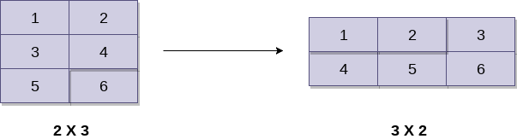
Reshaping the Array
By the shape of the array, we mean the number of rows and columns of a multi-dimensional array. However, the numpy module provides us the way to reshape the array by changing the number of rows and columns of the multi-dimensional array.
The reshape() function associated with the ndarray object is used to reshape the array. It accepts the two parameters indicating the row and columns of the new shape of the array.

Slide 19
Reshaping the Array
Example:
import numpy as np
a = np.array([[1,2],[3,4],[5,6]])
print("printing the original array..")
print(a)
a=a.reshape(2,3)
print("printing the reshaped array..")
print(a)
Output: printing the original array..
[[1 2]
[3 4]
[5 6]]
printing the reshaped array..
[[1 2 3]
[4 5 6]]

Slide 20
Iterating Array
Iterating means going through elements one by one.
As we deal with multi-dimensional arrays in numpy, we can do this using basic for loop of python.
If we iterate on a 1-D array it will go through each element one by one.
Example:
import numpy as np arr = np.array([1, 2, 3]) for x in arr: print(x)

Slide 21
Iterating Array
Ouput: 1
2
3
Example:
import numpy as np arr = np.array([[1, 2, 3], [4, 5, 6]]) for x in arr: for y in x:
print(y)
Output:
[1 2 3] [4 5 6]

Slide 22
Numpy Built-in Functions
Numpy provides many built-in functions for easy and fast perfomance.
Functions like concatenate, append, where, random, clip, transpose, sort, floor, arrange, ceil, unique, zeros, sum, etc.
We will discuss few of the functions like concatenate, append, sort, where, random in this chapter.

Slide 23
Concatenate
The concatenate() function is a function from the NumPy package. This function essentially combines NumPy arrays together.
This function is basically used for joining two or more arrays of the same shape along a specified axis.
There are the following things which are essential to keep in mind:
NumPy's concatenate() is not like a traditional database join. It is like stacking NumPy arrays.
This function can operate both vertically and horizontally. This means we can concatenate arrays together horizontally or vertically.

Slide 24
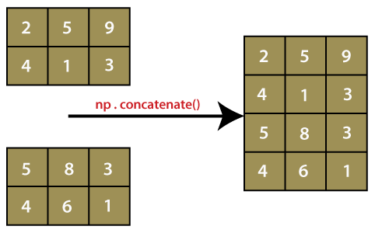
Concatenate
The concatenate() function is usually written as np.concatenate(), but we can also write it as numpy.concatenate(). It depends on the way of importing the numpy package, either import numpy as np or import numpy, respectively.

Slide 25
Concatenate
Syntax:
numpy.concatenate((a1, a2, ...), axis)
(a1, a2, ...) - This parameter defines the sequence of arrays. Here, a1, a2, a3 ... are the arrays which have the same shape, except in the dimension corresponding to the axis.
axis : int(optional) - This parameter defines the axis along which the array will be joined. By default, its value is 0.

Slide 26
Concatenate
Example - 1:
import numpy as np
x=np.array([[1,2],[3,4]])
y=np.array([[12,30]])
z=np.concatenate((x,y))
print(z)
Output:
array([[ 1, 2],
[ 3, 4],
[12, 30]])

Slide 27
Concatenate
Example - 2:
import numpy as np
x=np.array([[1,2],[3,4]])
y=np.array([[12,30]])
z=np.concatenate((x,y.T), axis=1)
print(z)
Output:
array([[ 1, 2, 12],
[ 3, 4, 30]])

Slide 28
Concatenate
Example - 3:
import numpy as np
x=np.array([[1,2],[3,4]])
y=np.array([[12,30]])
z=np.concatenate((x,y), axis=None)
print(z)
Output:
array([ 1, 2, 3, 4, 12, 30])

Slide 29
Append
The numpy.append() function is available in NumPy package. As the name suggests, append means adding something. The numpy.append() function is used to add or append new values to an existing numpy array. This function adds the new values at the end of the array.
The numpy append() function is used to merge two arrays. It returns a new array, and the original array remains unchanged.
Syntax:
numpy.append(arr, values, axis=None)

Slide 30
Append
arr: array_like - This is a ndarray. The new values are appended to a copy of this array. This parameter is required and plays an important role in numpy.append() function.
values: array_like - This parameter defines the values which are appended to a copy of a ndarray. One thing is to be noticed here that these values must be of the correct shape as the original ndarray, excluding the axis. If the axis is not defined, then the values can be in any shape and will flatten before use.
axis: int(optional) - This parameter defines the axis along which values are appended. When the axis is not given to them, both ndarray and values are flattened before use.

Slide 31
Append
Example -1:
import numpy as np
a=np.array([[10, 20, 30], [40, 50, 60], [70, 80, 90]]
b=np.array([[11, 21, 31], [42, 52, 62], [73, 83, 93]]
c=np.append(a,b,axis=0)
print(c)
Output:
array([[ 10, 20, 30],
[ 40, 50, 60],
[ 70, 80, 90],
[11, 21, 31],
[42, 52, 62],
[73, 83, 93]])

Slide 32
Append
Example -2:
import numpy as np
a=np.array([[10, 20, 30], [40, 50, 60], [70, 80, 90]]
b=np.array([[11, 21, 31], [42, 52, 62], [73, 83, 93]]
c=np.append(a,b,axis=1)
print(c)
Output:
array([[ 10, 20, 30, 11, 21, 31],
[ 40, 50, 60, 42, 52, 62],
[ 70, 80, 90, 73, 83, 93]])

Slide 33
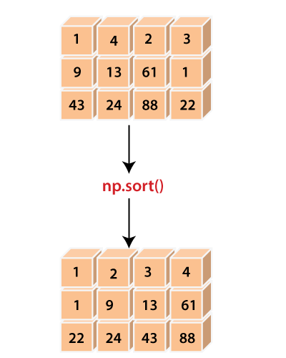
Sort
In some cases, we require a sorted array for computation. For this purpose, the numpy module of Python provides a function called numpy.sort(). This function gives a sorted copy of the source array or input array.

Slide 34
Sort
Syntax:
numpy.sort(a,axis=-1,kind='quicksort',order=None)
a: array_like - This parameter defines the source array, which is going to be sorted.
axis: int or None(optional) - This parameter defines the axis along which the sorting is performed. If this parameter is None, the array will be flattened before sorting, and by default, this parameter is set to -1, which sorts the array along the last axis.

Slide 35
Sort
kind: {quicksort,heapsort, mergesort} (optional) - This parameter is used to define the sorting algorithm, and by default, the sorting is performed using 'quicksort'.
order: str or list of str(optional) - When an array is defined with fields, its order defines the fields for making a comparison in first, second, etc. Only the single field can be specified as a string, and not necessarily for all fields. However, the unspecified fields will still be used, in the order in which they come up in the dtype, to break the ties.

Slide 36
Sort
Example - 1:
import numpy as np
x=np.array([[1,4,2,3],[9,13,61,1],[43,24,88,22]])
print(x)
y=np.sort(x)
print(y)
Output:
array([[ 1, 4, 2, 3],
[ 9, 13, 61, 1],
[43, 24, 88, 22]])
array([[ 1, 2, 3, 4],
[ 1, 9, 13, 61],
[22, 24, 43, 88]])

Slide 37
Sort
Example - 2:
import numpy as np
x=np.array([[1,4,2,3],[9,13,61,1],[43,24,88,22]])
print(x)
y=np.sort(x, axis=None)
print(y)
Output:
array([[ 1, 4, 2, 3],
[ 9, 13, 61, 1],
[43, 24, 88, 22]])
array([ 1, 1, 2, 3, 4, 9, 13, 22, 24, 43, 61, 88])

Slide 38
Where
The NumPy module provides a function numpy.where() for selecting elements based on a condition. It returns elements chosen from a or b depending on the condition.
For example, if all arguments -> condition, a & b are passed in numpy.where() then it will return elements selected from a & b depending on values in bool array yielded by the condition.
If only the condition is provided, this function is a shorthand to the function np.asarray (condition).nonzero(). Although nonzero should be preferred directly, as it behaves correctly for subclasses.

Slide 39
Where
Syntax:
numpy.where(condition[, x, y])
condition: array_like, bool - If this parameter set to True, yield x otherwise yield y.
x, y: array_like: - This parameter defines the values from which to choose. The x, y, and condition need to be broadcastable to some shape.

Slide 40
Where
Example - 1:
import numpy as np
a=np.arange(12)
print(a)
b=np.where(a<6,a,5*a)
print(b)
Output:
[ 0 1 2 3 4 5 6 7 8 9 10 11]
[ 0 1 2 3 4 5 30 35 40 45 50 55]

Slide 41
Where
Example - 2:
import numpy as np
a=np.arange(12)
print(a)
b=np.where([[True,False],[True,True]],[[1,2],[3,4]],[[9,8],[7,6]])
print(b)
Output:
[ 0 1 2 3 4 5 6 7 8 9 10 11]
[[1 8]
[3 4]]

Slide 42
Random
The random is a module present in the NumPy library. This module contains the functions which are used for generating random numbers.
This module contains some simple random data generation methods, some permutation and distribution functions, and random generator functions.

Slide 43
Random
np.random.rand(d0, d1, ..., dn)
This function of random module is used to generate random numbers or values in a given shape.
Example:
import numpy as np
a=np.random.rand(5,2)
a
Output:
array([[0.74710182, 0.13306399],
[0.01463718, 0.47618842],
[0.98980426, 0.48390004],
[0.58661785, 0.62895758],
[0.38432729, 0.90384119]])

Slide 44
Random
np.random.randn(d0, d1, ..., dn)
This function of random module return a sample from the "standard normal" distribution.
Example:
import numpy as np
a=np.random.randn(2,2)
print(a)
b=np.random.randn()
print(b)
Output:
[[-0.41760217 0.29270737]
[-0.30304224 1.94522069]]
0.09426266198437167

Slide 45
Random
np.random.randint(low[, high, size, dtype])
This function of random module is used to generate random integers from inclusive(low) to exclusive(high).
Example:
import numpy as np
a=np.random.randint(3, size=10)
print(a)
Output:
[1 0 0 2 0 0 2 0 0 0]

Slide 46
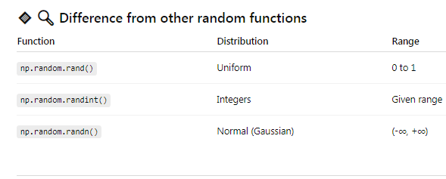
Differences-

Slide 47
Random
np.random.random([size])
This function of random module is used to generate random floats number in the half-open interval [0.0, 1.0).
Example:
import numpy as np
a=np.random.random()
print(a)
b=type(np.random.random())
print(b)
c=np.random.random((5,))
print(c)

Slide 48
Random
np.random.random([size])
Output:
0.3017357447992782
<class 'float'>
[0.73472103 0.20038042 0.97463732 0.23645754 0.61992921]

Slide 49
Matplotlib Introduction
Matplotlib is an amazing visualization library in Python for 2D plots of arrays.
Matplotlib is a multi-platform data visualization library built on NumPy arrays and designed to work with the broader SciPy stack.
It was introduced by John Hunter in the year 2002.
One of the greatest benefits of visualization is that it allows us visual access to huge amounts of data in easily digestible visuals.
Matplotlib consists of several plots like line, bar, scatter, histogram etc.
Matplotlib comes with a wide variety of plots. Plots helps to understand trends, patterns, and to make correlations. They’re typically instruments for reasoning about quantitative information.

Slide 50
Pyplot
The plot() function is used to draw points (markers) in a diagram.
By default, the plot() function draws a line from point to point.
The function takes parameters for specifying points in the diagram.
Parameter 1 is an array containing the points on the x-axis.
Parameter 2 is an array containing the points on the y-axis.
If we need to plot a line from (1, 3) to (8, 10), we have to pass two arrays [1, 8] and [3, 10] to the plot function.

Slide 51
Pyplot
Example to draw a line in a diagram from position (1, 3) to position (8, 10):
import matplotlib.pyplot as plt import numpy as np
xpoints = np.array([1, 8]) ypoints = np.array([3, 10])
plt.plot(xpoints, ypoints) plt.show()

Slide 52
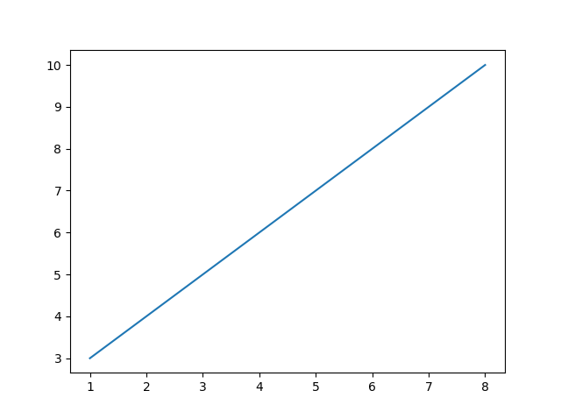
Pyplot

Slide 53
Plotting Without Line
To plot only the markers, you can use shortcut string notation parameter 'o', which means 'rings'.
Example to draw a line in a diagram from position (1, 3) to position (8, 10):
import matplotlib.pyplot as plt import numpy as np
xpoints = np.array([1, 8]) ypoints = np.array([3, 10])
plt.plot(xpoints, ypoints, ‘o’) plt.show()

Slide 54
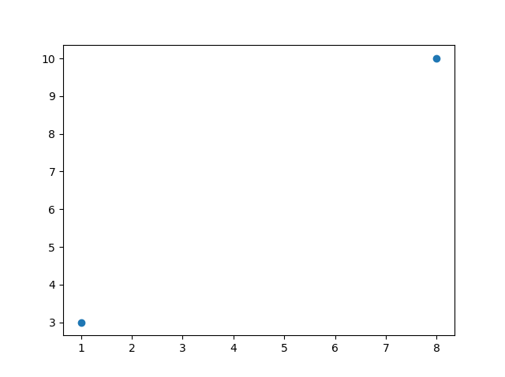
Plotting Without Line

Slide 55
Multiple Points
You can plot as many points as you like, just make sure you have the same number of points in both axis.
Example to draw a line in a diagram from position (1, 3) to (2, 8) then to (6, 1) and finally to position (8, 10):
import matplotlib.pyplot as plt import numpy as np
xpoints = np.array([1, 2, 6, 8]) ypoints = np.array([3, 8, 1, 10])
plt.plot(xpoints, ypoints) plt.show()

Slide 56
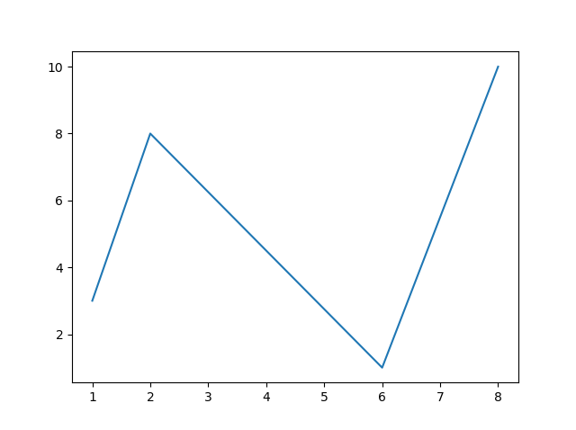
Multiple Points

Slide 57
Default X-Points
If we do not specify the points on the x-axis, they will get the default values 0, 1, 2, 3 (etc., depending on the length of the y-points.
Example to draw a line in a diagram from y-positions (3,8,1,10,5,7):
import matplotlib.pyplot as plt import numpy as np
ypoints = np.array([3, 8, 1, 10, 5, 7])
plt.plot(ypoints) plt.show()

Slide 58
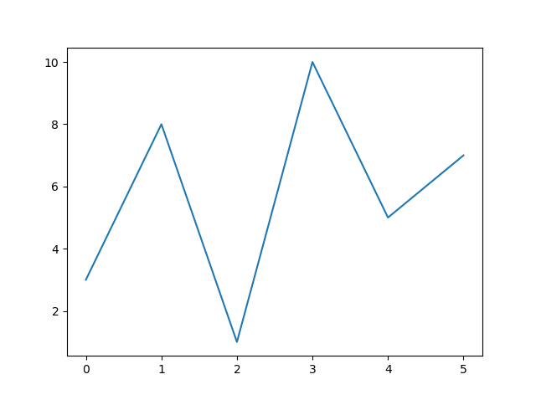
Default X-Points

Slide 59
Markers
You can use the keyword argument marker to emphasize each point with a specified marker.
Example to draw a line in a diagram from y-positions (3,8,1,10,5,7) and mark each point with a circle:
import matplotlib.pyplot as plt import numpy as np
ypoints = np.array([3, 8, 1, 10, 5, 7])
plt.plot(ypoints, marker = 'o') plt.show()

Slide 60
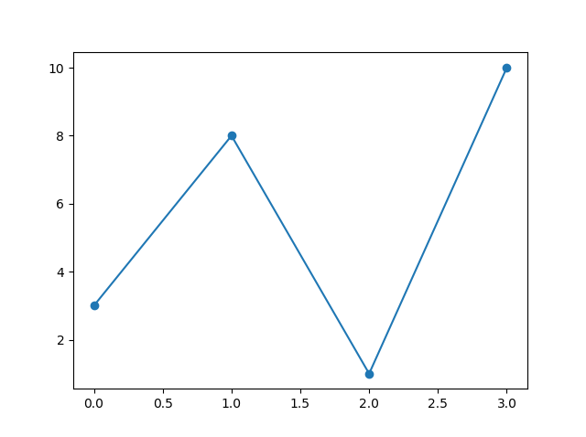
Markers

Slide 61
Markers
You can use the keyword argument marker to emphasize each point with a specified marker.
Example to draw a line in a diagram from y-positions (3,8,1,10,5,7) and mark each point with a star:
import matplotlib.pyplot as plt import numpy as np
ypoints = np.array([3, 8, 1, 10, 5, 7])
plt.plot(ypoints, marker = ‘*') plt.show()

Slide 62
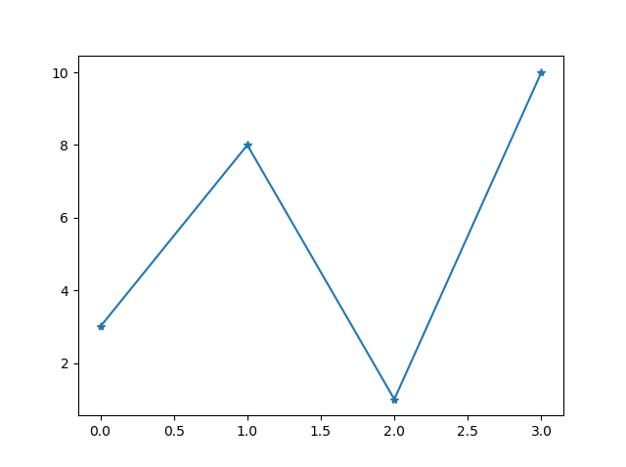
Markers

Slide 63
Marker Reference
Marker | Description | Marker | Description
'o' | Circle | 'H' | Hexagon
'*' | Star | 'h' | Hexagon
'.' | Point | 'v' | Triangle Down
',' | Pixel | '^' | Triangle Up
'x' | X | '<' | Triangle Left
'X' | X (filled) | '>' | Triangle Right
'+' | Plus | '1' | Tri Down
'P' | Plus (filled) | '2' | Tri Up
's' | Square | '3' | Tri Left
'D' | Diamond | '4' | Tri Right
'd' | Diamond (thin) | '|' | Vline
'p' | Pentagon | '_' | Hline

Slide 64
Markers
You can use also use the shortcut string notation parameter to specify the marker. This parameter is also called fmt, and is written with this syntax:
marker|line|color.
Example:
import matplotlib.pyplot as plt import numpy as np ypoints = np.array([3, 8, 1, 10]) plt.plot(ypoints, 'o:r') plt.show()

Slide 65
Markers
You can use the keyword argument markersize or the shorter version, ms to set the size of the markers. You can use the keyword argument markeredgecolor or the shorter mec to set the color of the edge of the markers.
Example:
import matplotlib.pyplot as plt import numpy as np ypoints = np.array([3, 8, 1, 10]) plt.plot(ypoints, marker = 'o', ms = 20, mec = 'r') plt.show()

Slide 66
Linestyle
You can use the keyword argument linestyle, or shorter ls, to change the style of the plotted line.
Example:
import matplotlib.pyplot as plt import numpy as np ypoints = np.array([3, 8, 1, 10]) plt.plot(ypoints, linestyle = 'dotted')
#plt.plot(ypoints, linestyle = ‘:') plt.show()

Slide 67
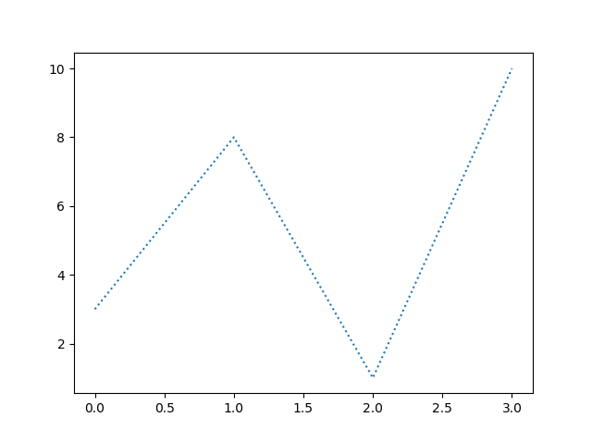
Linestyle

Slide 68
Linestyle Reference
Style | Or
'solid' (default) | '-'
'dotted' | ':'
'dashed' | '--'
'dashdot' | '-.'
'None' | '' or ' '

Slide 69
Linecolor
You can use the keyword argument color or the shorter c to set the color of the line.
Example:
import matplotlib.pyplot as plt import numpy as np ypoints = np.array([3, 8, 1, 10]) plt.plot(ypoints, color = 'r') plt.show()

Slide 70
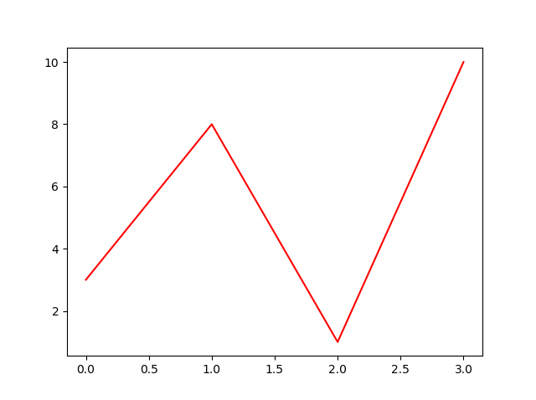
Linecolor

Slide 71
Linewidth
You can use the keyword argument linewidth or the shorter lw to change the width of the line.
Example:
import matplotlib.pyplot as plt import numpy as np ypoints = np.array([3, 8, 1, 10]) plt.plot(ypoints, linewidth = '20.5') plt.show()

Slide 72
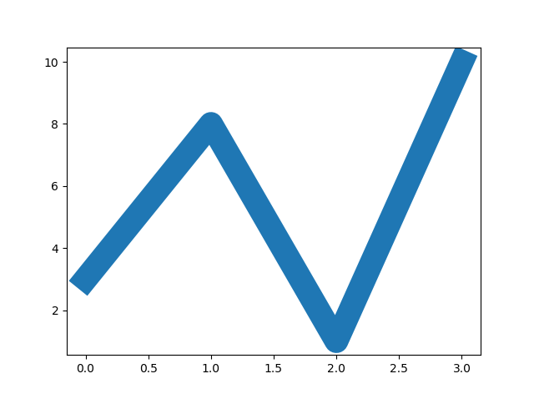
Linecolor

Slide 73
Multiple lines
You can plot as many lines as you like by simply adding more plt.plot() functions.
Example:
import matplotlib.pyplot as plt import numpy as np y1 = np.array([3, 8, 1, 10]) y2 = np.array([6, 2, 7, 11]) plt.plot(y1) plt.plot(y2)
plt.show()

Slide 74
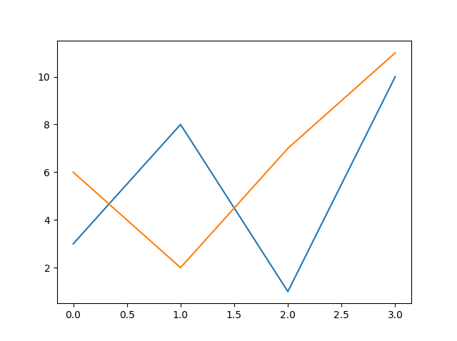
Linecolor

Slide 75
Labels for Plot
With Pyplot, you can use the xlabel() and ylabel() functions to set a label for the x- and y-axis.
Example:
import numpy as np
import matplotlib.pyplot as plt
x = np.array([80, 85, 90, 95, 100, 105, 110, 115, 120, 125])
y = np.array([240, 250, 260, 270, 280, 290, 300, 310, 320, 330])
plt.plot(x, y)
plt.xlabel("Average Pulse")
plt.ylabel("Calorie Burnage")
plt.show()

Slide 76
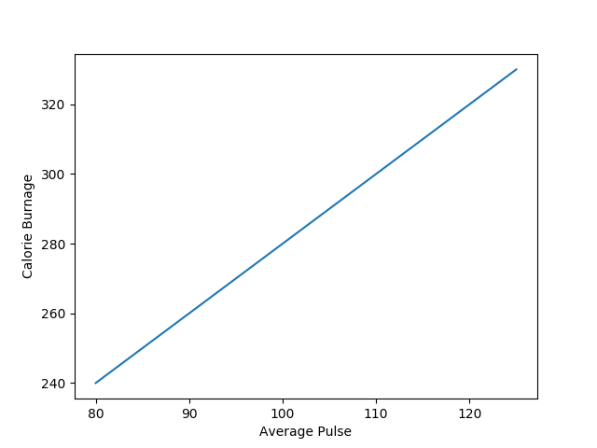
Labels for Plot

Slide 77
Title for Plot
With Pyplot, you can use the title() function to set a title for the plot.
Example:
import numpy as np
import matplotlib.pyplot as plt
x = np.array([80, 85, 90, 95, 100, 105, 110, 115, 120, 125])
y = np.array([240, 250, 260, 270, 280, 290, 300, 310, 320, 330])
plt.plot(x, y)
plt.title("Sports Watch Data")
plt.xlabel("Average Pulse")
plt.ylabel("Calorie Burnage")
plt.show()

Slide 78
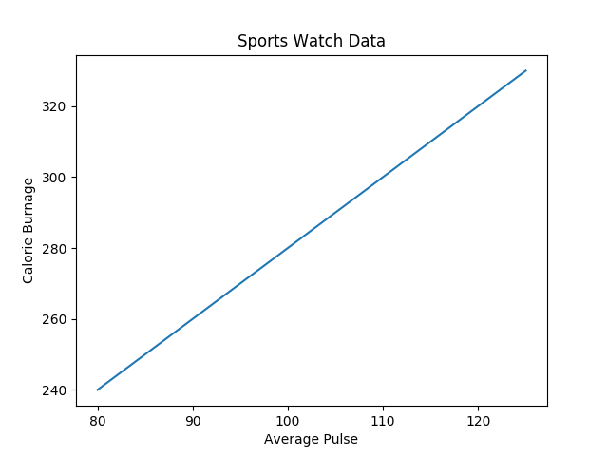
Title for Plot

Slide 79
Font Properties
With Pyplot, you can use the title() function to set a title for the plot.
Example:
….
font1 = {'family':'serif','color':'blue','size':20} font2 = {'family':'serif','color':'darkred','size':15} plt.title("Sports Watch Data", fontdict = font1) plt.xlabel("Average Pulse", fontdict = font2) plt.ylabel("Calorie Burnage", fontdict = font2) ….

Slide 80
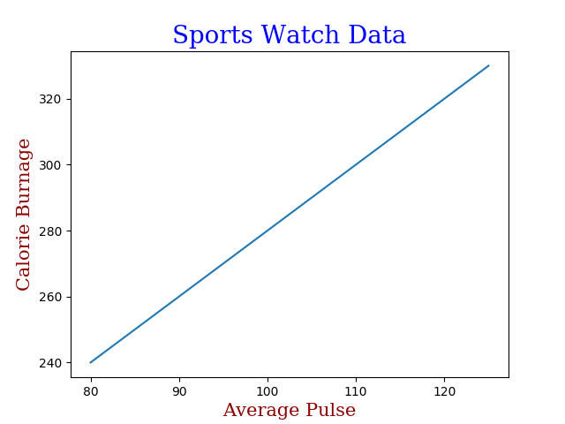
Font Properties

Slide 81
Position the Title
You can use the loc parameter in title() to position the title. Legal values are: 'left', 'right', and 'center'. Default value is 'center'.
Example:
import numpy as np
import matplotlib.pyplot as plt
x = np.array([80, 85, 90, 95, 100, 105, 110, 115, 120, 125])
y = np.array([240, 250, 260, 270, 280, 290, 300, 310, 320, 330])
plt.title("Sports Watch Data", loc = 'left')
plt.xlabel("Average Pulse")
plt.ylabel("Calorie Burnage")
plt.plot(x, y)
plt.show()

Slide 82
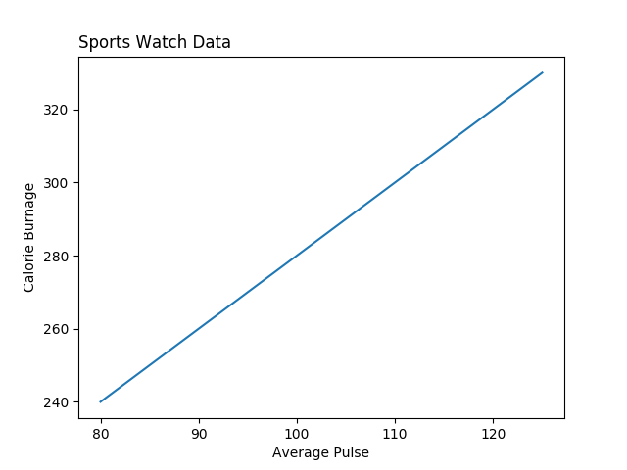
Position the Title

Slide 83
Grid
With Pyplot, you can use the grid() function to add grid lines to the plot.
Example:
import numpy as np
import matplotlib.pyplot as plt
x = np.array([80, 85, 90, 95, 100, 105, 110, 115, 120, 125])
y = np.array([240, 250, 260, 270, 280, 290, 300, 310, 320, 330])
plt.title("Sports Watch Data")
plt.xlabel("Average Pulse")
plt.ylabel("Calorie Burnage")
plt.plot(x, y)
plt.grid()
plt.show()

Slide 84

Grid

Slide 85
Specific Gridlines
You can use the axis parameter in the grid() function to specify which grid lines to display.
Legal values are: 'x', 'y', and 'both'. Default value is 'both'.
Example:
plt.grid(axis = 'x')
Line Properties for the Grid
You can also set the line properties of the grid, like this: grid(color = 'color', linestyle = 'linestyle', linewidth = number).
Example:
plt.grid(color = 'green', linestyle = '--', linewidth = 0.5)

Slide 86
Subplot
With the subplot() function you can draw multiple plots in one figure:
Example:
import matplotlib.pyplot as plt
import numpy as np
#plot 1:
x = np.array([0, 1, 2, 3])
y = np.array([3, 8, 1, 10])
plt.subplot(1, 2, 1)
plt.plot(x,y)
#plot 2:
x = np.array([0, 1, 2, 3])
y = np.array([10, 20, 30, 40])
plt.subplot(1, 2, 2)
plt.plot(x,y)
plt.show()

Slide 87
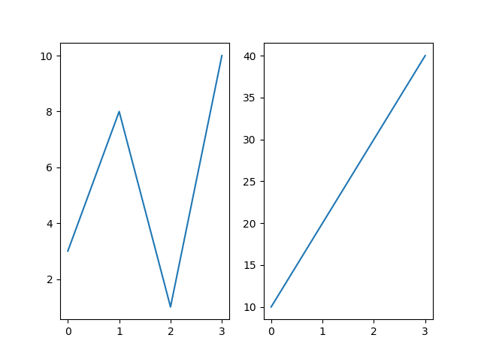
Subplot

Slide 88
Subplot
The subplot() function takes three arguments that describes the layout of the figure.
The layout is organized in rows and columns, which are represented by the first and second argument.
The third argument represents the index of the current plot.
plt.subplot(1, 2, 1)
#the figure has 1 row, 2 columns, and this plot is the first plot.
plt.subplot(1, 2, 2)
#the figure has 1 row, 2 columns, and this plot is the second plot.

Slide 89
Subplot
If we want a figure with 2 rows an 1 column (meaning that the two plots will be displayed on top of each other instead of side-by-side), we can write the syntax like this:
Example:
import matplotlib.pyplot as plt
import numpy as np
#plot 1:
x = np.array([0, 1, 2, 3])
y = np.array([3, 8, 1, 10])
plt.subplot(2, 1, 1)
plt.plot(x,y)
#plot 2:
x = np.array([0, 1, 2, 3])
y = np.array([10, 20, 30, 40])
plt.subplot(2, 1, 2)
plt.plot(x,y)
plt.show()

Slide 90
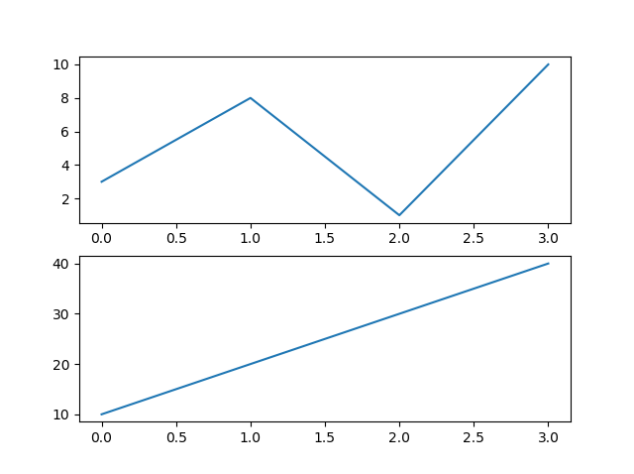
Subplot

Slide 91
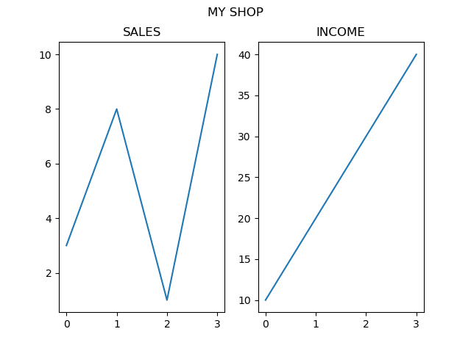
Super title in Subplot
You can add a title to the entire figure with the suptitle() function:
Example:
plt.suptitle("MY SHOP")

Slide 92
Scatter Plot
With Pyplot, you can use the scatter() function to draw a scatter plot.
The scatter() function plots one dot for each observation. It needs two arrays of the same length, one for the values of the x-axis, and one for values on the y-axis:
Example:
import matplotlib.pyplot as plt
import numpy as np
x = np.array([5,7,8,7,2,17,2,9,4,11,12,9,6])
y = np.array([99,86,87,88,111,86,103,87,94,78,77,85,86])
plt.scatter(x, y)
plt.show()

Slide 93
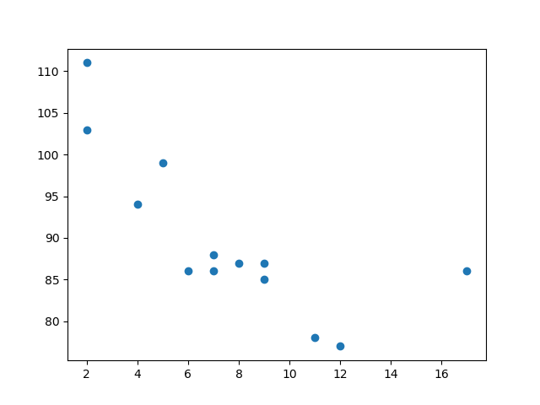
Scatter Plot

Slide 94
Scatter Plot
The observation in the example above is the result of 13 cars passing by.
The X-axis shows how old the car is.
The Y-axis shows the speed of the car when it passes.
Are there any relationships between the observations?
It seems that the newer the car, the faster it drives, but that could be a coincidence, after all we only registered 13 cars.

Slide 95
Compare Plots
In the example above, there seems to be a relationship between speed and age, but what if we plot the observations from another day as well? Will the scatter plot tell us something else?
Example:
import matplotlib.pyplot as plt
import numpy as np
#day one, the age and speed of 13 cars:
x = np.array([5,7,8,7,2,17,2,9,4,11,12,9,6])
y = np.array([99,86,87,88,111,86,103,87,94,78,77,85,86])
plt.scatter(x, y)
#day two, the age and speed of 15 cars:
x = np.array([2,2,8,1,15,8,12,9,7,3,11,4,7,14,12])
y = np.array([100,105,84,105,90,99,90,95,94,100,79,112,91,80,85])
plt.scatter(x, y)
plt.show()

Slide 96
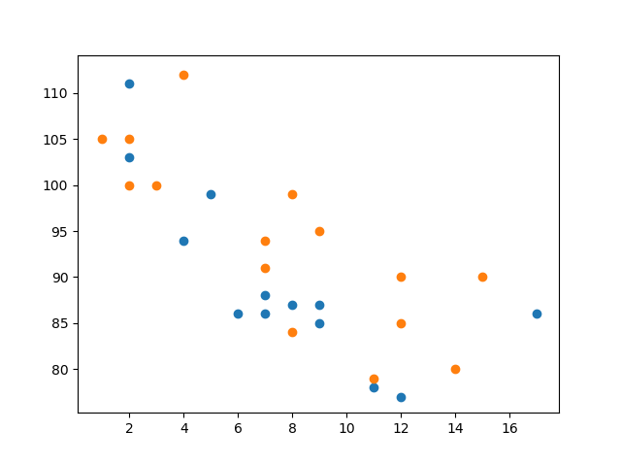
Compare Plot

Slide 97
Colors
You can set your own color for each scatter plot with the color or the c argument:
plt.scatter(x, y, color = 'hotpink')
plt.scatter(x, y, color = '#88c999')
Color Each Dot
You can even set a specific color for each dot by using an array of colors as value for the c argument:
Example:
x = np.array([5,7,8,7,2,17,2,9,4,11,12,9,6])
y = np.array([99,86,87,88,111,86,103,87,94,78,77,85,86])
colors = np.array(["red","green","blue","yellow","pink","black","orange","purple","beige","brown","gray","cyan","magenta"])
plt.scatter(x, y, c=colors)

Slide 98
Bar Graph
With Pyplot, you can use the bar() function to draw bar graphs:
The bar() function takes arguments that describes the layout of the bars.
The categories and their values represented by the first and second argument as arrays.
Example:
import matplotlib.pyplot as plt
import numpy as np
x = np.array(["A", "B", "C", "D"])
y = np.array([3, 8, 1, 10])
plt.bar(x,y)
plt.show()

Slide 99
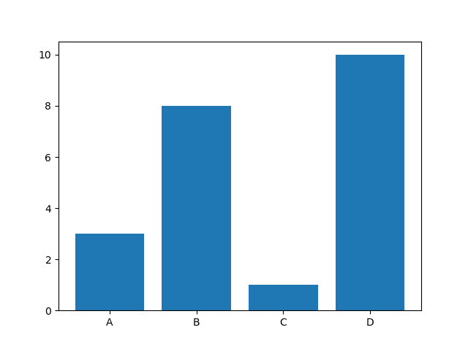
Bar Graph

Slide 100
Horizontal Bar graph
If you want the bars to be displayed horizontally instead of vertically, use the barh() function:
Example:
import matplotlib.pyplot as plt
import numpy as np
x = np.array(["A", "B", "C", "D"])
y = np.array([3, 8, 1, 10])
plt.barh(x, y)
plt.show()

Slide 101
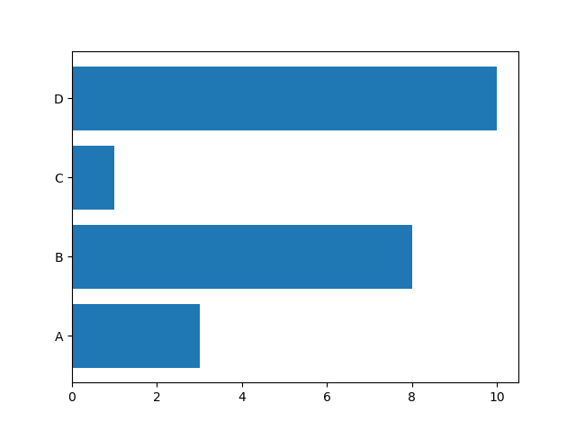
Horizontal Bar Graph

Slide 102
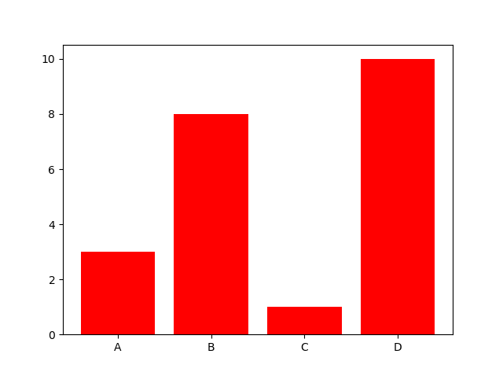
Bar Color
The bar() and barh() take the keyword argument color to set the color of the bars:
Example: plt.bar(x, y, color = "red")
plt.bar(x, y, color = "#4CAF50")

Slide 103
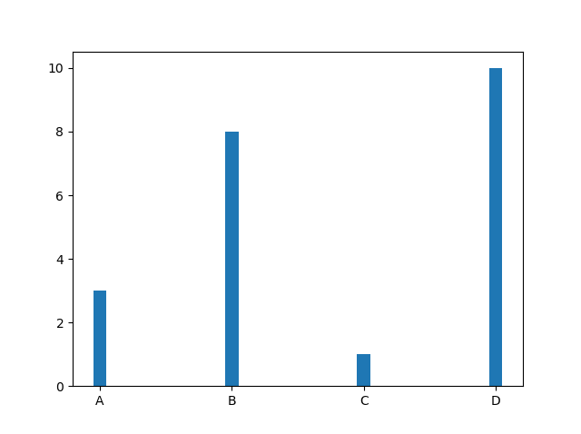
Bar Width
The bar() takes the keyword argument width to set the width of the bars:
Example: plt.bar(x, y, width = 0.1)
The default width value is 0.8

Slide 104
Pie Chart
With Pyplot, you can use the pie() function to draw pie charts:
Example:
import matplotlib.pyplot as plt
import numpy as np
y = np.array([35, 25, 25, 15])
plt.pie(y)
plt.show()

Slide 105
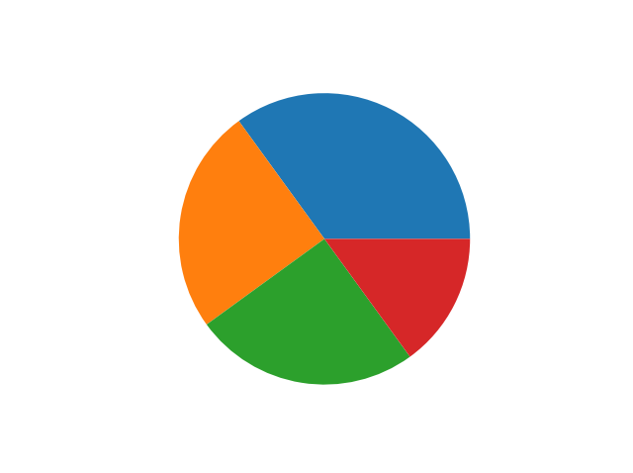
Pie Chart

Slide 106
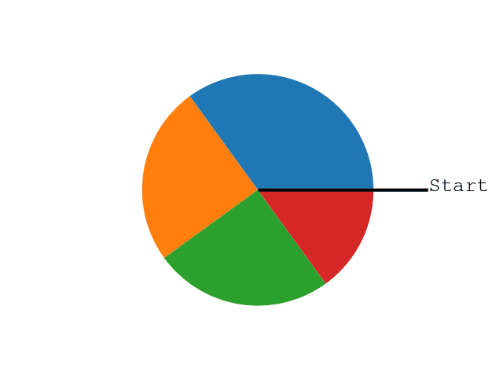
Pie Chart
As you can see the pie chart draws one piece (called a wedge) for each value in the array (in this case [35, 25, 25, 15]).
By default the plotting of the first wedge starts from the x-axis and moves counterclockwise:

Slide 107
Labels
Add labels to the pie chart with the label parameter.
The label parameter must be an array with one label for each wedge:
Example:
import matplotlib.pyplot as plt
import numpy as np
y = np.array([35, 25, 25, 15])
mylabels = ["Apples", "Bananas", "Cherries", "Dates"]
plt.pie(y, labels = mylabels)
plt.show()

Slide 108
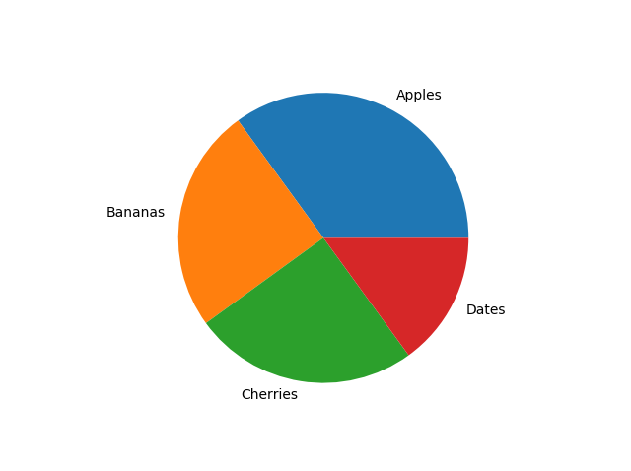
Labels

Slide 109
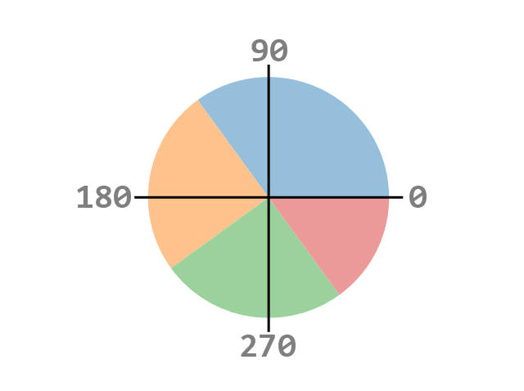
Start angle
As mentioned the default start angle is at the x-axis, but you can change the start angle by specifying a startangle parameter.
The startangle parameter is defined with an angle in degrees, default angle is 0:

Slide 110
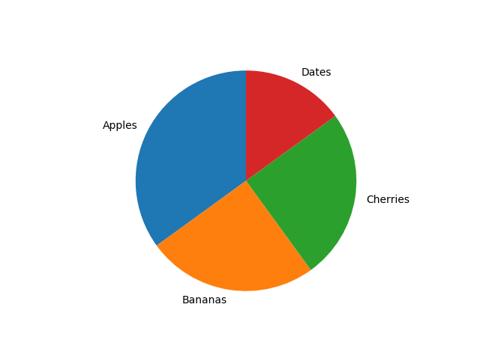
Start angle
Example:
import matplotlib.pyplot as plt
import numpy as np
y = np.array([35, 25, 25, 15])
mylabels = ["Apples", "Bananas", "Cherries", "Dates"]
plt.pie(y, labels = mylabels, startangle = 90)
plt.show()

Slide 111
Explode
The explode parameter, if specified, and not None, must be an array with one value for each wedge.
Each value represents how far from the center each wedge is displayed:
Example : Pull the "Apples" wedge 0.2 from the center of the pie:
import matplotlib.pyplot as plt
import numpy as np
y = np.array([35, 25, 25, 15])
mylabels = ["Apples", "Bananas", "Cherries", "Dates"]
myexplode = [0.2, 0, 0, 0]
plt.pie(y, labels = mylabels, explode = myexplode)
plt.show()

Slide 112
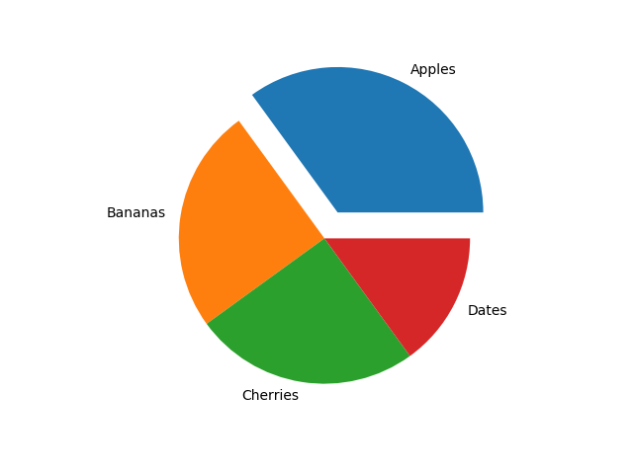
Explode

Slide 113
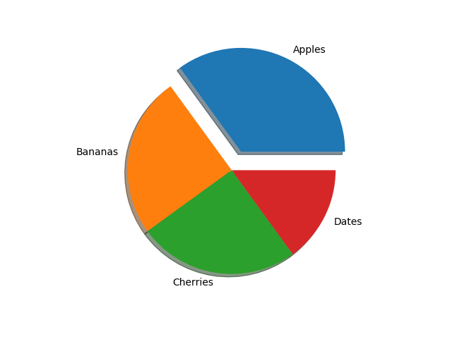
Shadow
Add a shadow to the pie chart by setting the shadows parameter to True:
Example:
plt.pie(y, labels = mylabels, explode = myexplode, shadow = True)

Slide 114
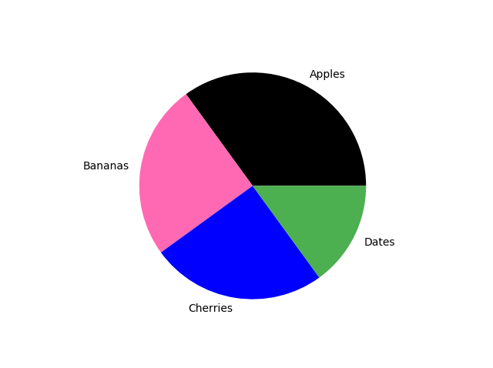
Colors
You can set the color of each wedge with the colors parameter.
The colors parameter, if specified, must be an array with one value for each wedge:
Example:
mylabels = ["Apples", "Bananas", "Cherries", "Dates"]
mycolors = ["black", "hotpink", "b", "#4CAF50"]
plt.pie(y, labels = mylabels, colors = mycolors)

Slide 115
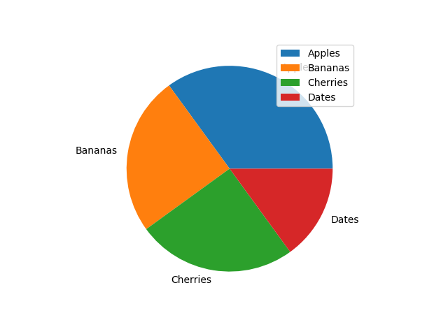
Legend
To add a list of explanation for each wedge, use the legend() function:
Example:
y = np.array([35, 25, 25, 15])
mylabels = ["Apples", "Bananas", "Cherries", "Dates"]
plt.pie(y, labels = mylabels)
plt.legend()
plt.show()

Slide 116
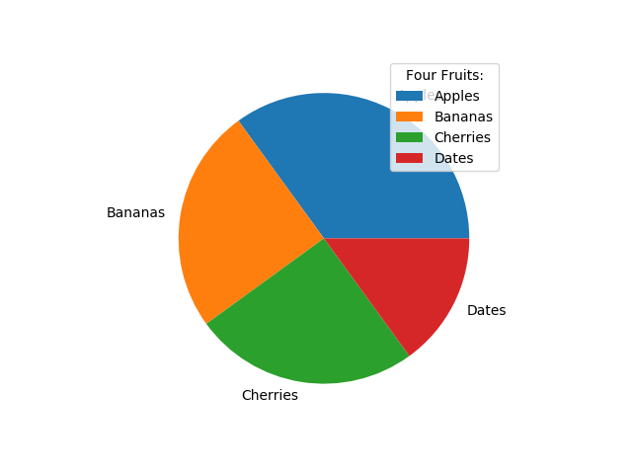
Legend With Header
To add a header to the legend, add the title parameter to the legend function.
Example:
plt.legend(title = "Four Fruits:")

Slide 117
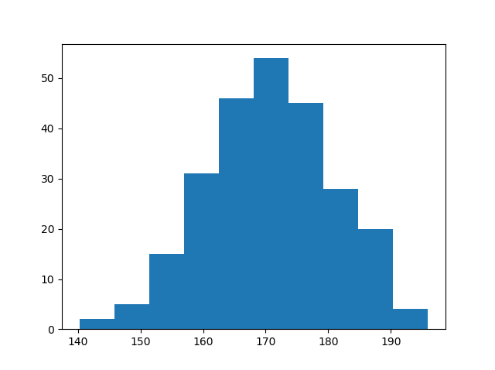
Histogram
A histogram is a graph showing frequency distributions.
It is a graph showing the number of observations within each given interval.
Example: Say you ask for the height of 250 people, you might end up with a histogram like this:

Slide 118
Histogram
You can read from the histogram that there are approximately:
2 people from 140 to 145cm
5 people from 145 to 150cm
15 people from 151 to 156cm
31 people from 157 to 162cm
46 people from 163 to 168cm
53 people from 168 to 173cm
45 people from 173 to 178cm
28 people from 179 to 184cm
21 people from 185 to 190cm
4 people from 190 to 195cm

Slide 119
Histogram
In Matplotlib, we use the hist() function to create histograms.
The hist() function will use an array of numbers to create a histogram, the array is sent into the function as an argument.
For simplicity we use NumPy to randomly generate an array with 250 values, where the values will concentrate around 170, and the standard deviation is 10.
Example:
import numpy as np
x = np.random.normal(170, 10, 250)
plt.hist(x)
plt.show()

Slide 120
Histogram

